Slide 1


Report on Working of Ward Committees in the City of Mumbai and Civic Problems Registered by Citizens
(January 2011 to December 2012)
Supported by:
FORD FOUNDATION

Slide 2

Praja’s Ward Committee Report 2013

Slide 3
Top Four Civic Complaints in Mumbai during 2011 & 2012
Issues | Complaints |  | Increase from 2011 to 2012 (in %)
 | 2011 | 2012
Roads | 5177 | 29852 | 476.6%
Drainage | 10203 | 16194 | 58.7%
Solid Waste Management (SWM) | 6489 | 6562 | 1.1%
Water Supply | 6231 | 6215 | -0.3%
Other Complaints | 32133 | 33891 | 5.5%
Mumbai | 60,233 | 92,714 | 53.9%
The increase in Road related complaints is primarily due to the new Potholes complaint system developed by the corporation. This only emphasises the need for a technologically advanced, centralised, user friendly and effective complaints redressal mechanism.

Slide 4
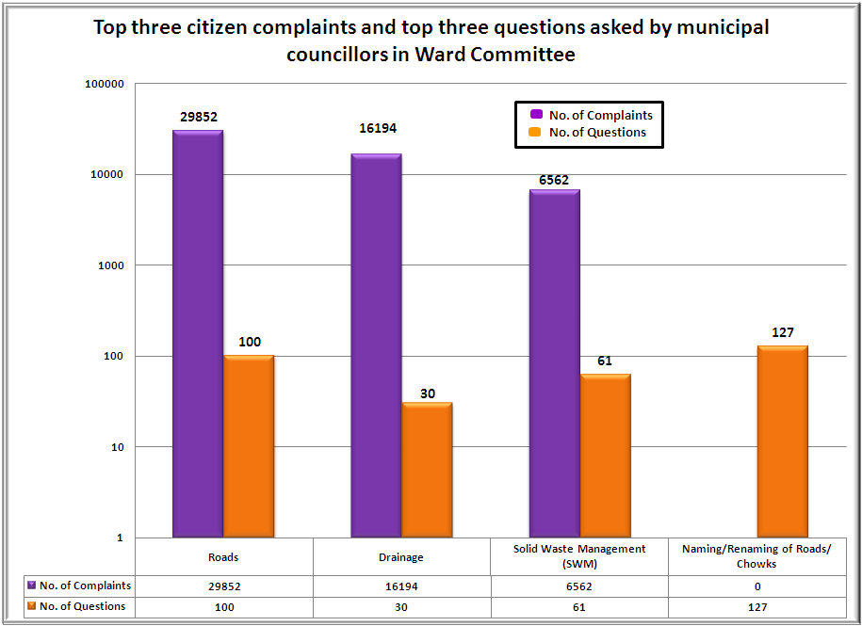
Comparison between top three citizen complaints and top three questions asked by municipal councillors in the Ward Committees in calendar year 2012

Slide 5
Number of questions asked issue-wise in Ward Committees during Mar’12 to Dec’12
Issues | Question asked (Mar’12 to Dec’12)
Drainage | 30
Solid Waste Management (SWM) | 61
Water Supply | 47
License | 29
Roads | 100
Storm Water Drainage | 31
Toilet | 17
Pest control | 11
Garden/Open space | 28
Community Development | 13
Health | 19
Education | 19
Naming/Renaming of Roads/ Chowks | 127
Other issues related | 140
Total | 672
1 out of every 5 question on naming/renaming of roads/chowks

Slide 6
Number of questions asked by Councillors in Ward Committees during Mar’12 to Dec’12
Category | No. of Members
Zero Question | 45
1 Question | 36
2 to 5 Questions | 114
6 to 10 Questions | 29
Above 10 Questions | 3
Out of the 36 councillors who have asked only one question in the ward committee, eight of the councillors have asked that one question on naming/renaming of roads/chowks

Slide 7
Praja’s Initiative
- Councillor Handbooks
- Councillor Workshops

Slide 8
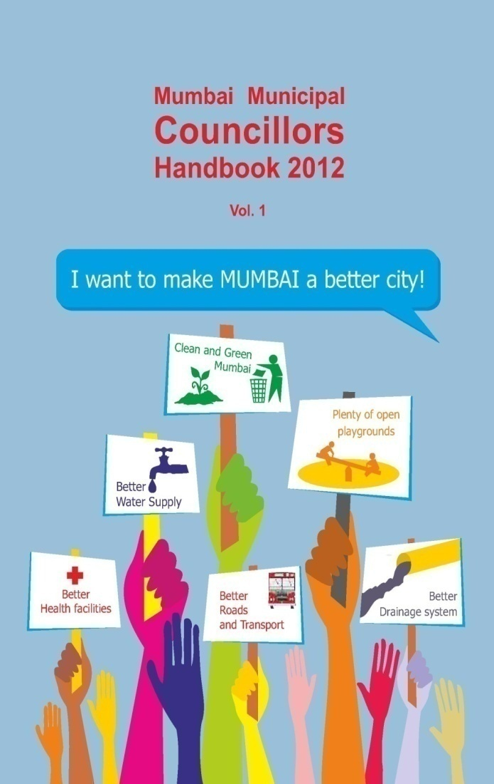
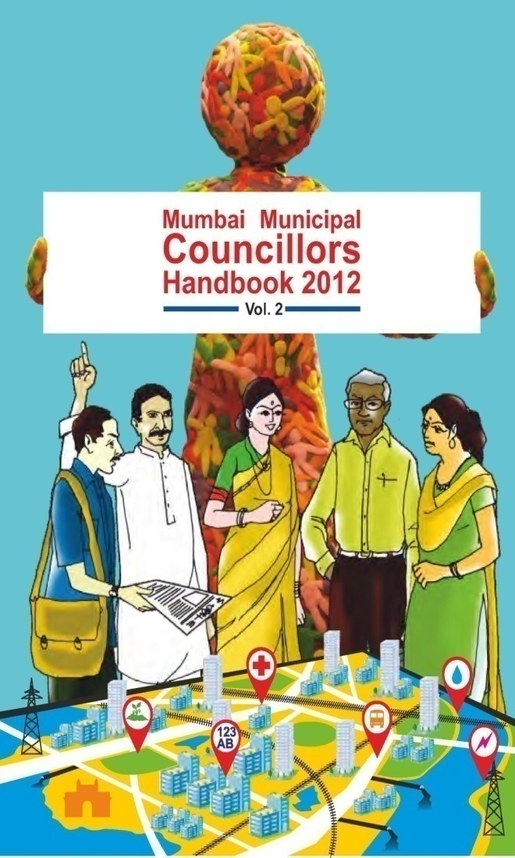
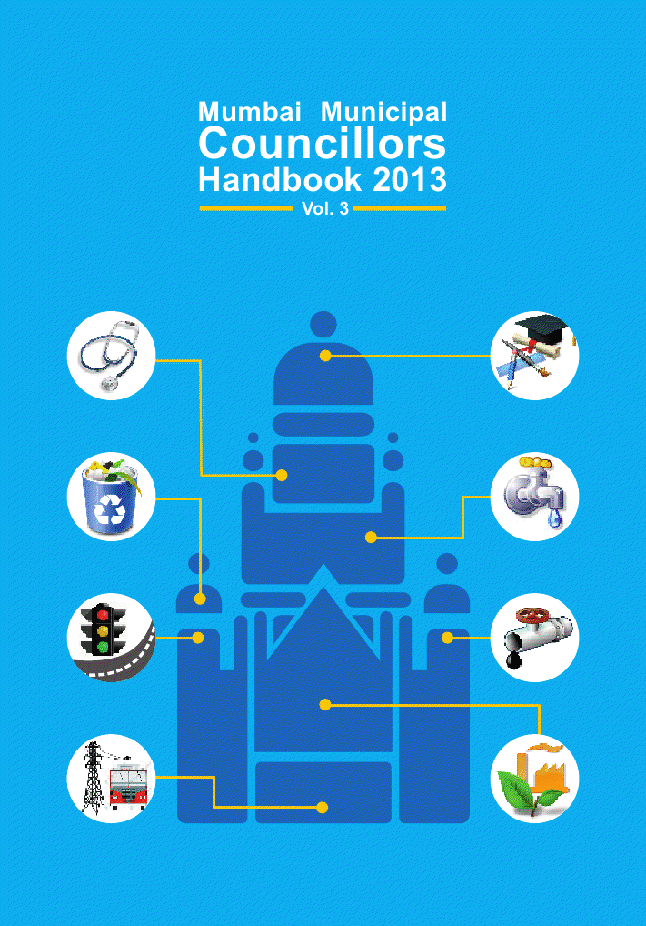
Praja’s Municipal Councillor Handbooks (and Workshops)
Vol. 1: Overview of Mumbai Municipal Corporation Act, 1888
Vol. 2: Corporation Procedure, Rules Municipal Budgeting, and
Development Plans
Vol. 3: MCGM Departments: Functions

Slide 9
